Slide 1

STC customer churn prediction

Slide 2
01
02
03
04
Introduction
Problem Statment
Solution Process
Final Result

Slide 3
Introduction
STC is a pioneer digital champion, always been focused on innovation and evolution, thinking about the future to make it, to stay ahead as a truly meaningful and purposeful organization. STC offers a variety of ICT solutions and digital services telecommunication. It aspires to increase the quality of customer satisfaction and to know the reasons for customer churn. in addition to predicting behavior to retain customers.

Slide 4
Our proplem statment
Churn is one of the biggest problems in the telecom industry. Research has shown that the average monthly churn rate among the top 4 wireless carriers in the US is 1.9% - 2%.

Slide 5
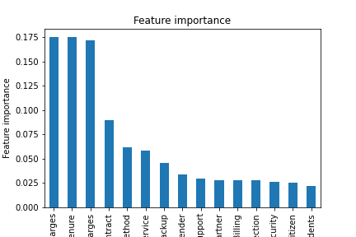
The Feature values
Most important
Total Charges
Tenure
Monthly Charges
Contract
Payment Method
Internet Service
Online Backup
Gender
Tech Support
Less importance:
Senior Citizen
Partner
Dependents
Online Security
Device Protection
Paperless Billing

Slide 6
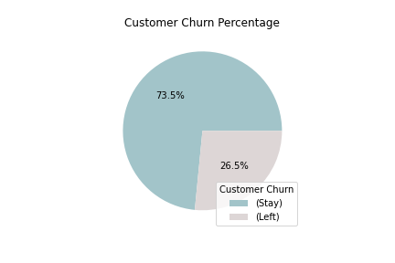
Our target value Percentage

Slide 7
Modelling
Training Scores
Validation Scores
Baseline model scores
The Accuracy score is 0.80
The f1 score is 0.60
The precision score is 0.65
The recall score is 0.56
The Accuracy score is 0.79
The f1 score is 0.58
The precision score is 0.64
The recall score is 0.52

Slide 8
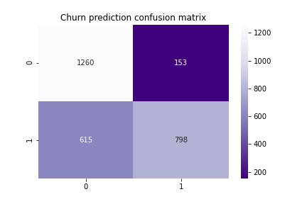
The Churn prediction Confusion Matrix in LR

Slide 9
Model’s Scores (Training)
 | F1 | precision | Recall
KNN | 0.98 | 0.98 | 0.98
Logistic Regression(up sample) | 0.77 | 0.74 | 0.80
Random Forest | 0.99 | 0.99 | 0.99

Slide 10
Model’s Scores (Validation)
 | F1 | precision | Recall
KNN | 0.50 | 0.54 | 0.46
Logistic Regression(up sample) | 0.63 | 0.51 | 0.82
Random Forest | 0.50 | 0.6 | 0.43

Slide 11
Stacking Classifier
The Accuracy score is 0.78
The f1 score is 0.54
The precision score is 0.63
The recall score is 0.64

Slide 12
The best model
Logistic Regression(up sample)

Slide 13
Thanks!
Does anyone have any questions?

